Slide 1
PROJECT SUBMISSION • DBMS
GYM MEMBERSHIP
TRACKER
A relational database solution for gym administration
Patel Parth (26D2DIT001)
Shivam Desai (26D2DIT015)
Maulin Vaniya (26D2DIT0012) • Jaimit Patel (26D2DIT007)
INFORMATION TECHNOLOGY | ACADEMIC YEAR 2026–2027

Slide 2
Project Overview
What the Gym Membership Tracker is designed to do
One organized place for the gym’s core records.
MEMBERS
PLANS
Profiles, contact details and membership dates
Duration, price and availability
The proposed system centralizes member profiles, membership plans, trainer assignments and payment history in a relational database.
TRAINERS
PAYMENTS
Profiles and member assignments
Transactions, methods and status
Focus: routine front-desk operations and useful management reports.
02

Slide 3
Problem Statement & Objectives
Why a structured system is useful
THE PROBLEM
PROJECT OBJECTIVES
Manual registers and scattered spreadsheets can cause:
• Duplicate member records
• Missed membership renewals
• Inconsistent payment information
• Slow searches and reporting
• Keep member records searchable and unique
• Manage plans and trainer assignments
• Identify active, expired and expiring memberships
• Maintain payment history
• Generate collection and operational reports
• Improve consistency using keys and validation
03

Slide 4
Scope of the Project
Included capabilities and current boundaries
IN SCOPE
OUT OF SCOPE FOR VERSION 1
✓ Register, view, search and update members
✓ Manage plans and trainers
✓ Track membership start/end dates
✓ Record and review payments
✓ Reports for expiry and collections
✓ Basic validation and duplicate prevention
× Online payment gateway processing
× Automatic SMS/email notifications
× Attendance scanning or biometric access
× Payroll, inventory and workout scheduling
These can be considered for future development.
04

Slide 5
Database Design & Relationships
Four principal entities connected through primary and foreign keys
1 : M
PLANS
MEMBERS
1 : M
Plan_ID (PK)
Plan_Name • Price
Duration_Months
Member_ID (PK)
Plan_ID (FK)
Trainer_ID (FK)
Membership dates
PAYMENT_HISTORY
Payment_ID (PK)
Member_ID (FK)
Date • Amount • Status
TRAINERS
Trainer_ID (PK)
Name • Phone
Specialization
Plans → Members: one plan can be selected by many members.
Trainers → Members: one trainer can be assigned to many members.
Members → Payment_History: one member can have multiple payment records.
05

Slide 6
Relational Schema & Normalization
Designed to reduce repeated data and preserve consistency
PLANS
Plan_ID (PK), Plan_Name, Duration_Months, Price, Description, Is_Active
TRAINERS
Trainer_ID (PK), Trainer_Name, Phone, Email, Specialization, Is_Active
MEMBERS
Member_ID (PK), Full_Name, Phone, Email, Join_Date, Membership_Start/End, Plan_ID (FK), Trainer_ID (FK)
PAYMENT_HISTORY
Payment_ID (PK), Member_ID (FK), Payment_Date, Amount, Payment_Method, Payment_Status
1NF: atomic values • 2NF: no partial dependencies • 3NF: non-key facts stored with their own entity
06

Slide 7
Implementation Approach
Reference SQL design uses MySQL 8.0-compatible syntax
DDL
DML
SQL REPORTS
CREATE DATABASE
CREATE TABLE
PRIMARY KEY / FOREIGN KEY
CHECK and UNIQUE constraints
INSERT sample records
UPDATE member or plan status
Use safe conditions
Avoid unnecessary hard deletes
JOIN member, plan and trainer
Expiry lists
Monthly paid collections
Payment history and plan counts
Implementation note: use parameterized queries and server-side validation in a complete application.
07

Slide 8
Operational Queries & Reports
Examples of questions the database can answer
Membership expiry
Expired members
Which active memberships expire in the next 7 days?
Which active records have an end date before today?
Monthly collections
Payment follow-up
How many successful payments and how much was collected each month?
Which payments are pending or failed?
Trainer workload
Plan popularity
How many active members are assigned to each trainer?
How many members currently use each plan?
08

Slide 9
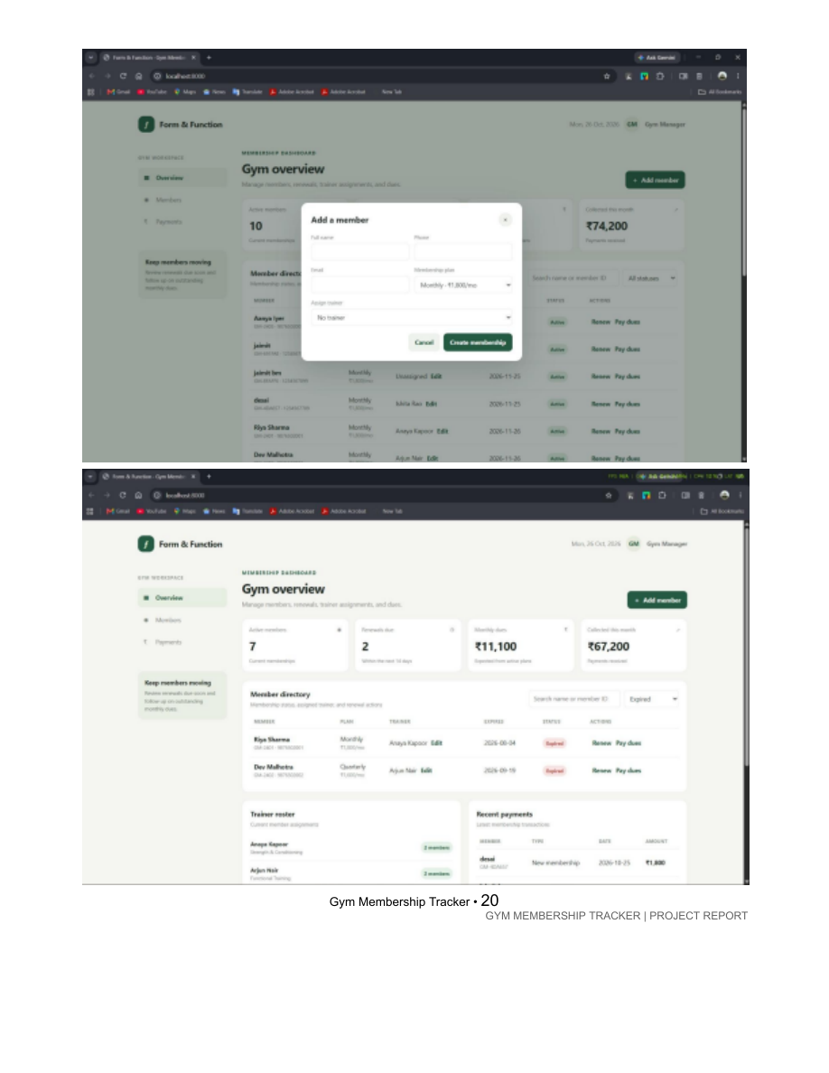
Interface Concepts & Testing
The report includes proposed layouts and a test plan
TEST CASES TO EXECUTE
• Register and search a member
• Assign a plan and optional trainer
• Record a payment
• Check upcoming and expired memberships
• Validate duplicate contacts and invalid amounts
• Verify report totals against sample data
Important: the report states that test results are pending actual execution; verify against the final application.
09

Slide 10
Limitations & Future Enhancements
A foundation that can be extended
CURRENT LIMITATIONS
FUTURE IMPROVEMENTS
• Current plan and dates are stored on Members; full renewal history is limited
• Payments are manually recorded
• No automatic notifications or gateway integration
• Wireframes are proposed, and tests remain to be executed
• Add a Memberships table for full history
• Staff accounts, roles and audit logs
• Payment gateway integration
• Email/SMS renewal reminders with consent
• Revenue and member-growth charts
• QR attendance, exports and scheduled backups
10

Slide 11
CONCLUSION
A clearer, more consistent way to manage gym records.
• Centralizes members, plans, trainers and payments.
• Uses relational keys and normalization to reduce duplication.
• Supports expiry tracking, payment follow-up and reporting.
• Provides a practical starting point for a complete gym administration application.
Gym Membership Tracker | Database Management System | 2026–2027

Slide 12
Thank you

